Slide 1

Poisson Regression – Part 1
Nina Gunnes
February 18, 2021

Slide 2
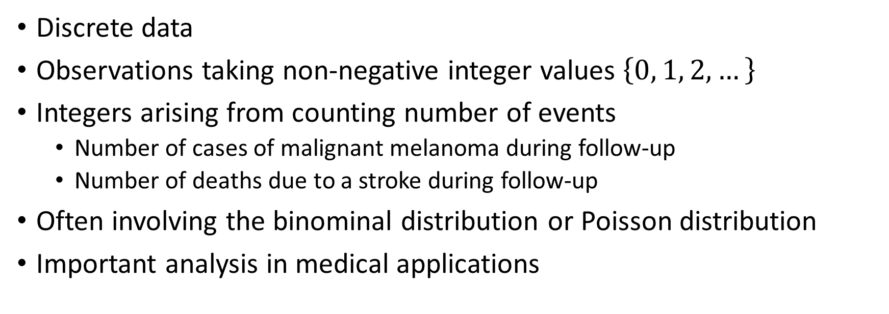
Count data
Discrete data
Observations taking non-negative integer values $\left\{0, 1, 2,…\right\}$
Integers arising from counting number of events
  Number of cases of malignant melanoma during follow-up
  Number of deaths due to a stroke during follow-up
Often involving the binominal distribution or Poisson distribution
Important analysis in medical applications

Slide 3
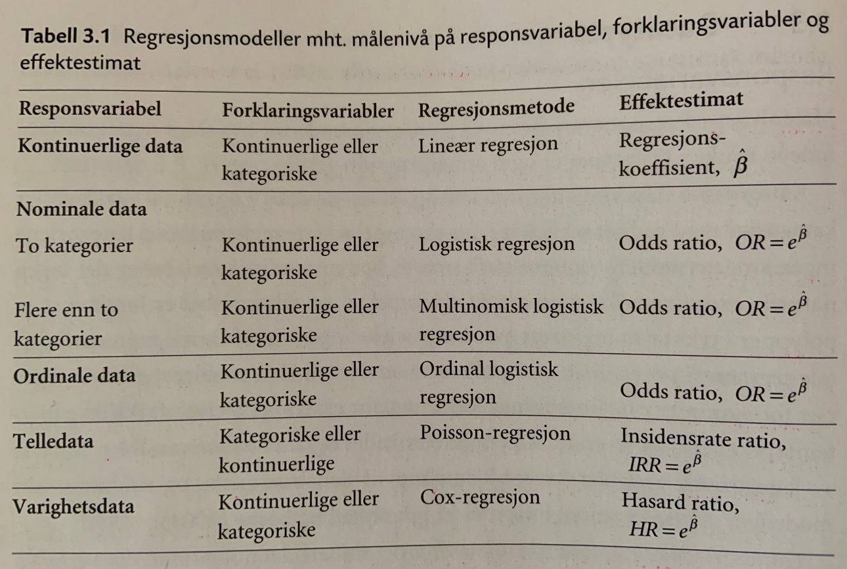
Count data, cont.
Table 3.1 in Laake et al. (2007)

Slide 4
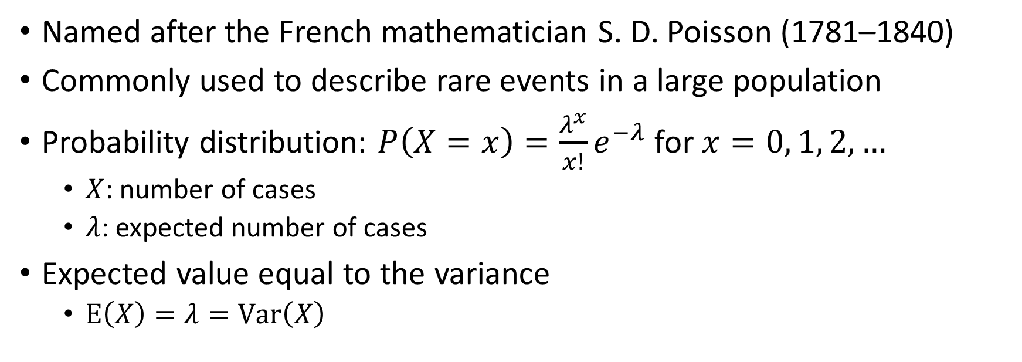
Poisson distribution
Named after the French mathematician S. D. Poisson (1781–1840)
Commonly used to describe rare events in a large population
Probability distribution: $P\left(X=x\right)=\frac{λ^{x}}{x!}e^{−λ}$ for $x=0, 1, 2,…$
  $X$: number of cases
  $λ$: expected number of cases
Expected value equal to the variance
  $\text{E}\left(X\right)=λ=\text{Var}\left(X\right)$

Slide 5
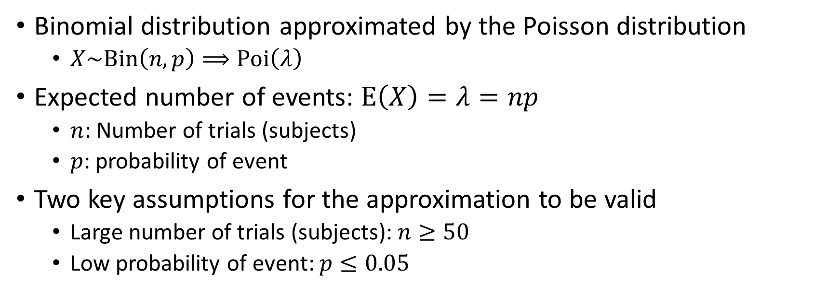
Poisson approximation to the binomial
Binomial distribution approximated by the Poisson distribution
  $X\sim \text{Bin}\left(n,p\right)⟹\text{Poi}\left(λ\right)$
Expected number of events: $\text{E}\left(X\right)=λ=np$
  $n$: Number of trials (subjects)
  $p$: probability of event
Two key assumptions for the approximation to be valid
  Large number of trials (subjects): $n≥50$
  Low probability of event: $p≤0.05$

Slide 6
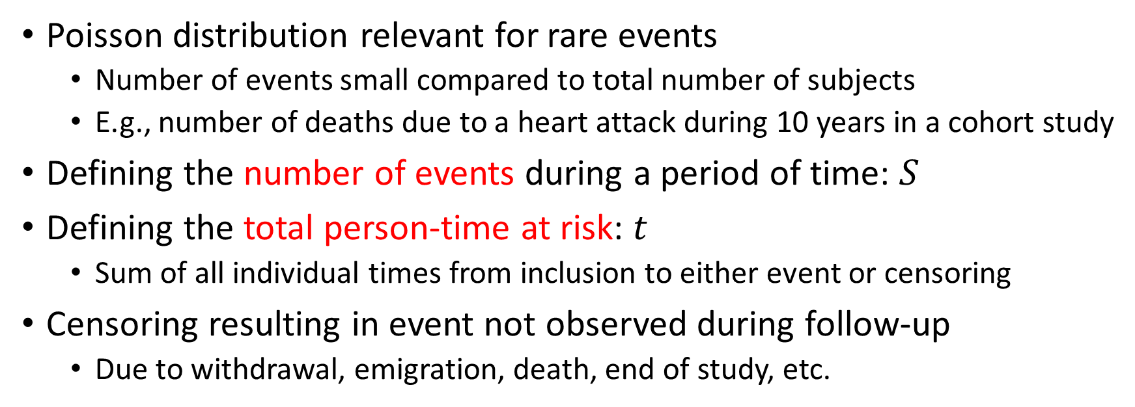
Incidence rate
Poisson distribution relevant for rare events
  Number of events small compared to total number of subjects
  E.g., number of deaths due to a heart attack during 10 years in a cohort study
Defining the number of events during a period of time: $S$
Defining the total person-time at risk: $t$
  Sum of all individual times from inclusion to either event or censoring
Censoring resulting in event not observed during follow-up
  Due to withdrawal, emigration, death, end of study, etc.

Slide 7
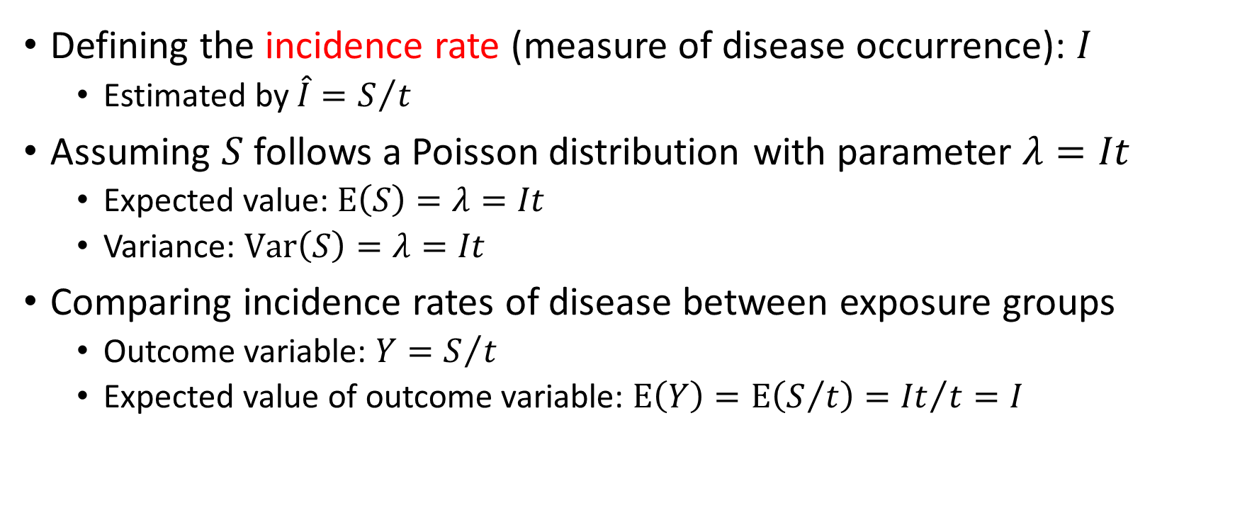
Incidence rate, cont.
Defining the incidence rate (measure of disease occurrence): $I$
  Estimated by $\hat{I}=S/t$
Assuming $S$ follows a Poisson distribution with parameter $λ=It$
  Expected value: $\text{E}\left(S\right)=λ=It$
  Variance: $\text{Var}\left(S\right)=λ=It$
Comparing incidence rates of disease between exposure groups
  Outcome variable: $Y=S/t$
  Expected value of outcome variable: $\text{E}\left(Y\right)=\text{E}\left(S/t\right)={It}/t=I$

Slide 8



Incidence rate, cont.
$$S$$
$$I$$
$$t$$

Slide 9
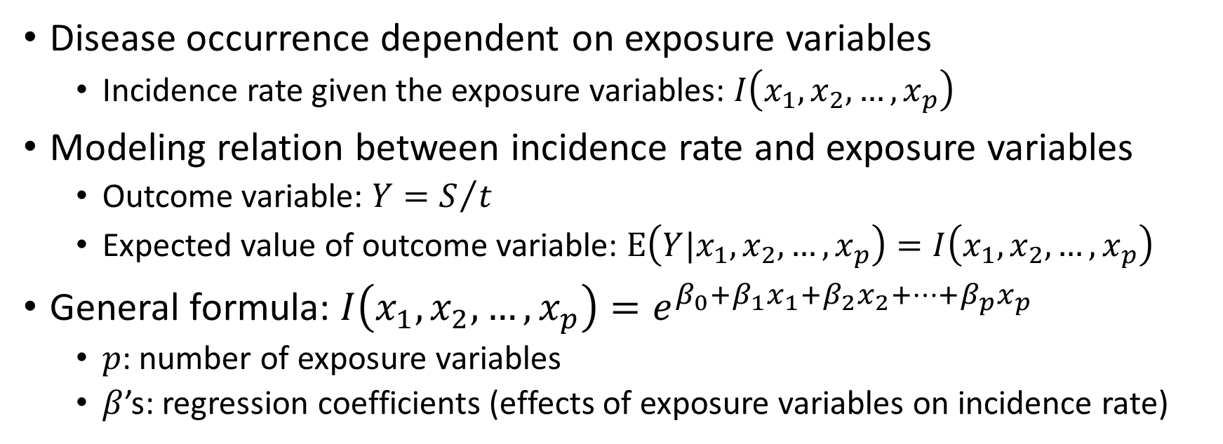
Poisson regression
Disease occurrence dependent on exposure variables
  Incidence rate given the exposure variables: $I\left(x_{1},x_{2},…,x_{p}\right)$
Modeling relation between incidence rate and exposure variables
  Outcome variable: $Y=S/t$
  Expected value of outcome variable: $\text{E}\left(Y|x_{1},x_{2},…,x_{p}\right)=I\left(x_{1},x_{2},…,x_{p}\right)$
General formula: $I\left(x_{1},x_{2},…,x_{p}\right)=e^{β_{0}+β_{1}x_{1}+β_{2}x_{2}+…+β_{p}x_{p}}$
  $p$: number of exposure variables
  $β$’s: regression coefficients (effects of exposure variables on incidence rate)

Slide 10
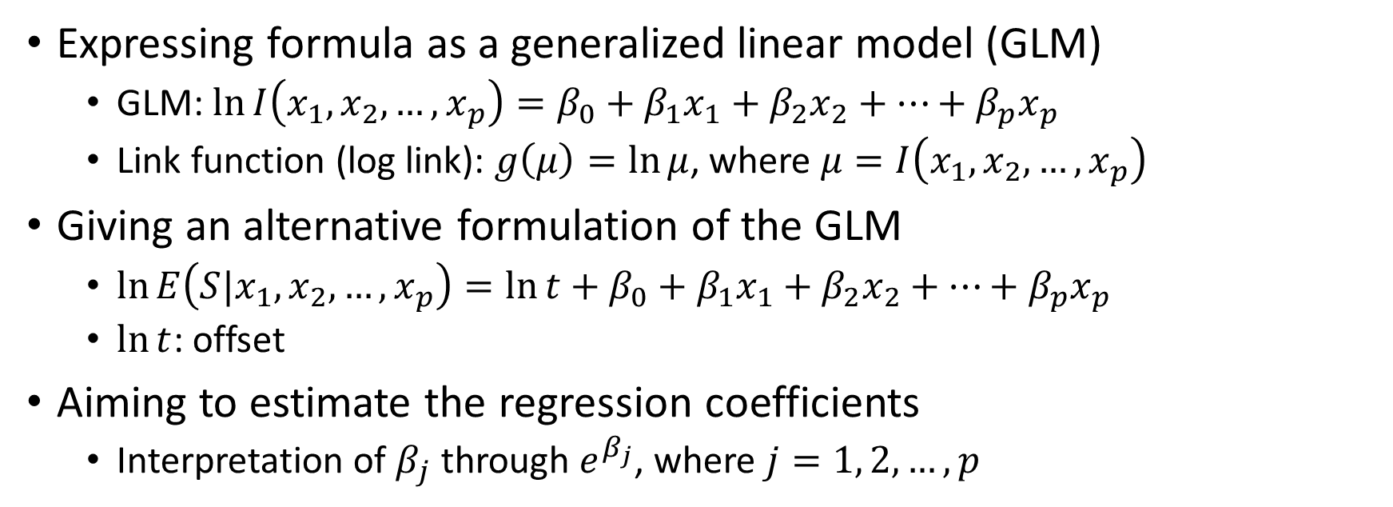
Poisson regression, cont.
Expressing formula as a generalized linear model (GLM)
  GLM: $\ln{I\left(x_{1},x_{2},…,x_{p}\right)}=β_{0}+β_{1}x_{1}+β_{2}x_{2}+…+β_{p}x_{p}$
  Link function (log link): $g\left(μ\right)=\ln{μ}$, where $μ=I\left(x_{1},x_{2},…,x_{p}\right)$
Giving an alternative formulation of the GLM
  $\ln{E\left(S|x_{1},x_{2},…,x_{p}\right)}=\ln{t}+β_{0}+β_{1}x_{1}+β_{2}x_{2}+…+β_{p}x_{p}$
  $\ln{t}$: offset
Aiming to estimate the regression coefficients
  Interpretation of $β_{j}$ through $e^{β_{j}}$, where $j=1, 2,…,p$

Slide 11
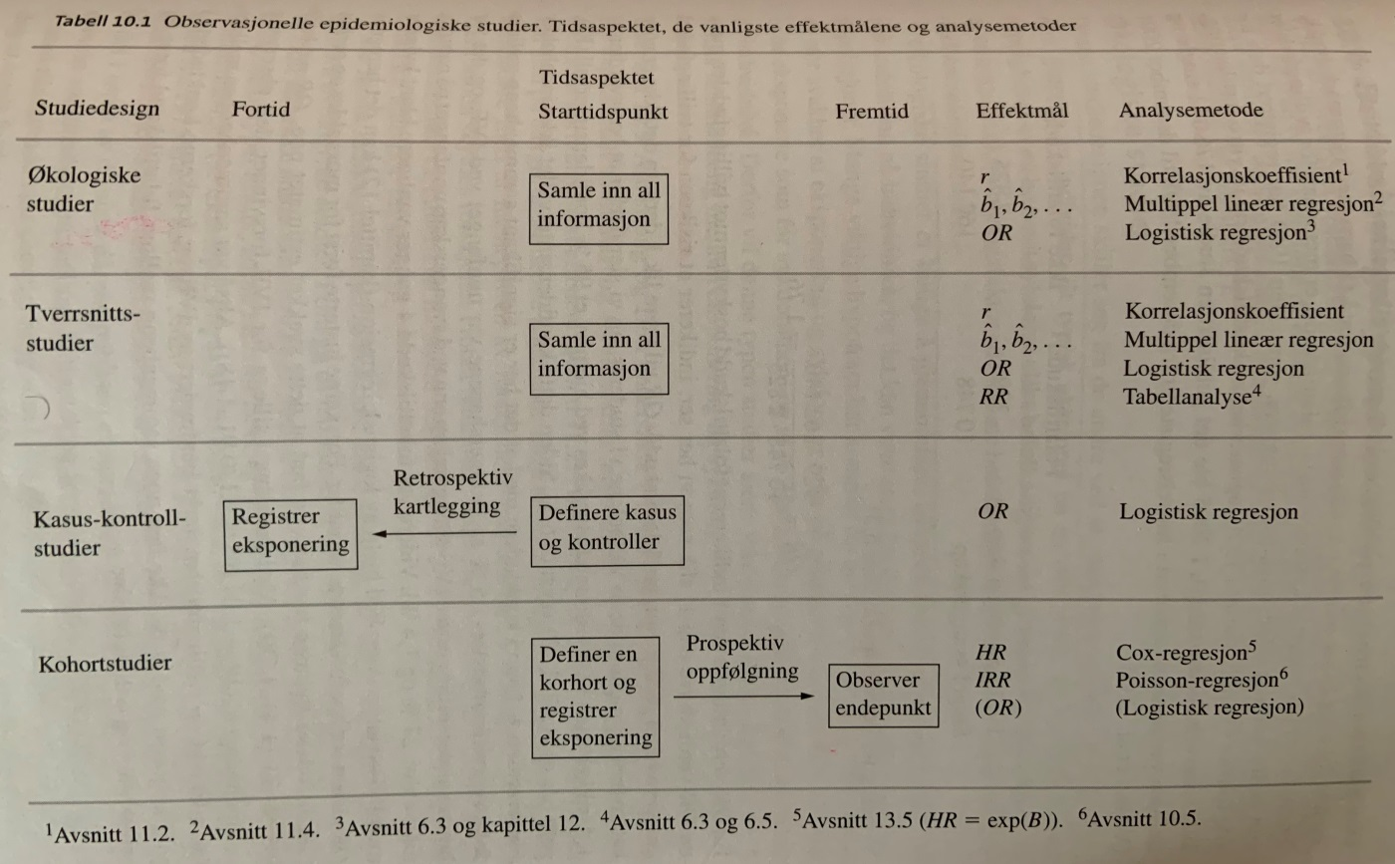
Poisson regression, cont.
Table 10.1 in Aalen et al. (2006)

Slide 12
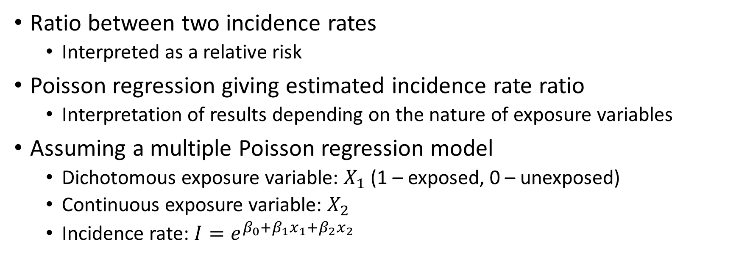
Incidence rate ratio
Ratio between two incidence rates
  Interpreted as a relative risk
Poisson regression giving estimated incidence rate ratio
  Interpretation of results depending on the nature of exposure variables
Assuming a multiple Poisson regression model
  Dichotomous exposure variable: $X_{1}$ (1 – exposed, 0 – unexposed)
  Continuous exposure variable: $X_{2}$
  Incidence rate: $I=e^{β_{0}+β_{1}x_{1}+β_{2}x_{2}}$

Slide 13
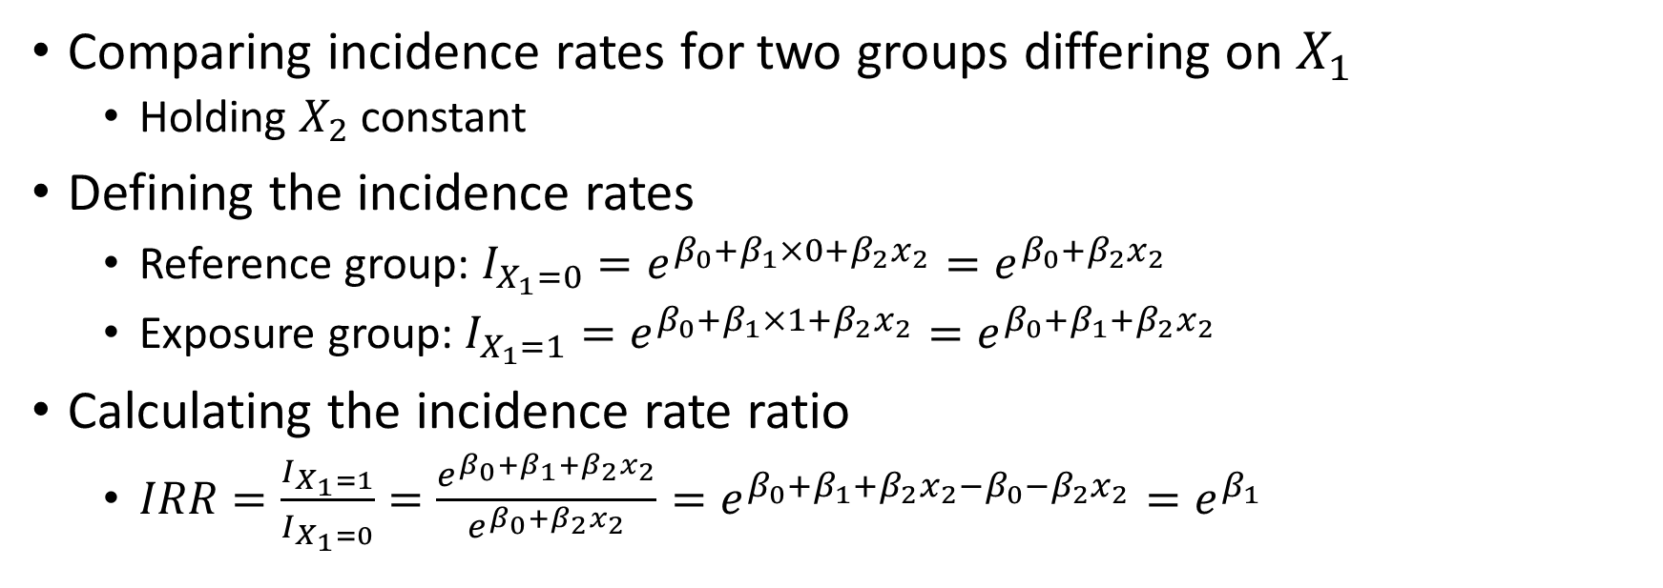
Incidence rate ratio, cont.
Comparing incidence rates for two groups differing on $X_{1}$
  Holding $X_{2}$ constant
Defining the incidence rates
  Reference group: $I_{X_{1}=0}=e^{β_{0}+β_{1}×0+β_{2}x_{2}}=e^{β_{0}+β_{2}x_{2}}$
  Exposure group: $I_{X_{1}=1}=e^{β_{0}+β_{1}×1+β_{2}x_{2}}=e^{β_{0}+β_{1}+β_{2}x_{2}}$
Calculating the incidence rate ratio
  $IRR=\frac{I_{X_{1}=1}}{I_{X_{1}=0}}=\frac{e^{β_{0}+β_{1}+β_{2}x_{2}}}{e^{β_{0}+β_{2}x_{2}}}=e^{β_{0}+β_{1}+β_{2}x_{2}−β_{0}−β_{2}x_{2}}=e^{β_{1}}$

Slide 14
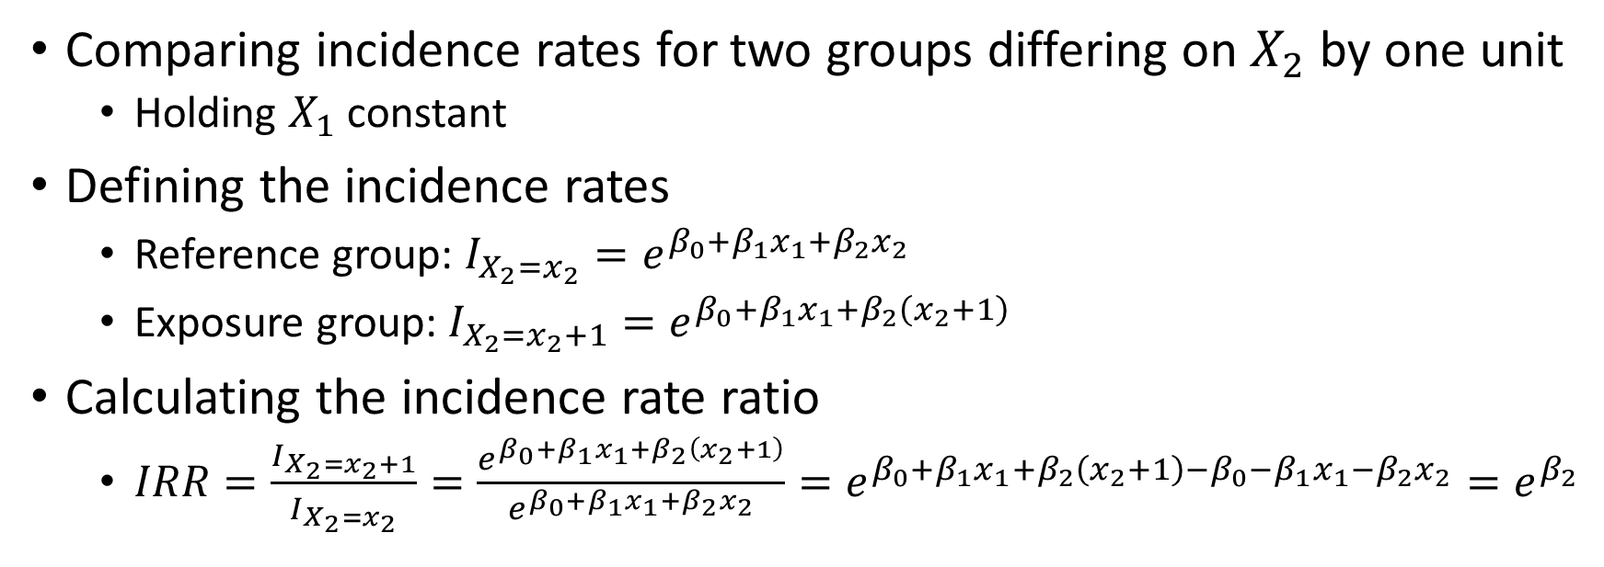
Incidence rate ratio, cont.
Comparing incidence rates for two groups differing on $X_{2}$ by one unit
  Holding $X_{1}$ constant
Defining the incidence rates
  Reference group: $I_{X_{2}=x_{2}}=e^{β_{0}+β_{1}x_{1}+β_{2}x_{2}}$
  Exposure group: $I_{X_{2}=x_{2}+1}=e^{β_{0}+β_{1}x_{1}+β_{2}\left(x_{2}+1\right)}$
Calculating the incidence rate ratio
  $IRR=\frac{I_{X_{2}=x_{2}+1}}{I_{X_{2}=x_{2}}}=\frac{e^{β_{0}+β_{1}x_{1}+β_{2}\left(x_{2}+1\right)}}{e^{β_{0}+β_{1}x_{1}+β_{2}x_{2}}}=e^{β_{0}+β_{1}x_{1}+β_{2}\left(x_{2}+1\right)−β_{0}−β_{1}x_{1}−β_{2}x_{2}}=e^{β_{2}}$

Slide 15

Incidence rate ratio, cont.
Value of the incidence rate ratio indicating reduced or increased risk
  $IRR<1$: reduced risk
  $IRR=1$: no difference in risk
  $IRR>1$: increased risk

Slide 16
References
Aalen OO, Frigessi A, Moger TA, Scheel I, Skovlund E, Veierød MB. Statistiske metoder i medisin og helsefag. Oslo: Gyldendal akademisk; 2006.
Laake P, Hjartåker A, Thelle DS, Veierød MB. Epidemiologiske og kliniske forskningsmetoder. Oslo: Gyldendal akademisk; 2007. https://www.med.uio.no/imb/forskning/publikasjoner/boker/2007/epidemiolgiske-kliniske-forskningsmetoder.html.

